Slide 1
Preprocessing & Layout Analysis for Offline Handwriting Recognition
東北大学大学院工学研究科
電子工学専攻川又研究室
Perttu Pitkänen

Slide 2
Overview
Handwriting recognition
Preprocessing
Layout Analysis
Tests
Conclusions
Future work

Slide 3
Handwriting recognition 1
Offline handwriting recognition (HWR) is the process of extracting text in digital form from handwritten images.
Offline recognition process can be divided into three main phases:
Preprocessing
Feature extraction
Classification
Implementation done with MATLAB and its image processing toolbox

Slide 4
Handwriting recognition 2
Preprocessing
Image is enhanced for feature extraction phase and the detected characters are segmented from the original image.
Layout analysis can be considered to be a part of preprocessing
Feature Extraction
Shape describing features are extracted from previously acquired objects.
Classification
Extracted features are used in machine learning algorithms to create the feature vector.

Slide 5
Preprocessing 1
Most of the preprocessing is same than previously
Image aquisition
Noise removal
Adaptive Wiener filter
Binarization
Sauvola algorithm
Object property analysis
Features such as holes in object, size, area or aspect ratio
Stroke width variation
All methods need pre-defined threshold values.
Object property analysis now uses sroke width instead of other features.

Slide 6
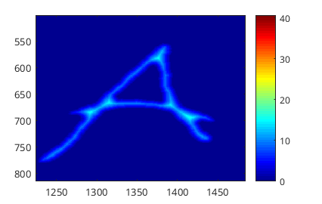
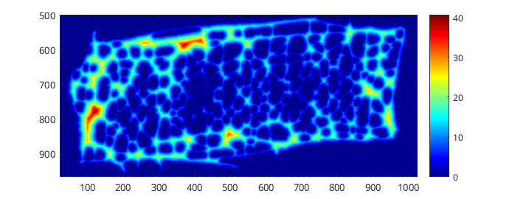
Stroke Width Analysis 1
One distinctive feature of text is that it consists of ”strokes”
Strokes have only a little variation in thickness.
Other objects such as images can have lot of variation in thickness.
The amount of variation can be used to distinquish text from other objects.
Dark blue represents thin stroke width and dark red thick strokes

Slide 7

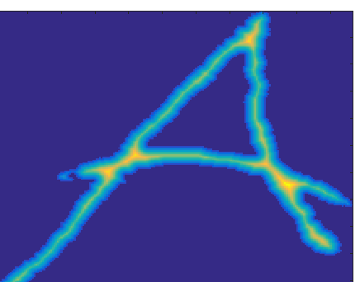
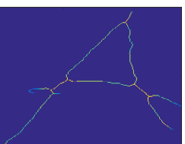
Stroke Width Analysis 2
Get image regions
Distance transform
For each pixel find distance to nearest black pixel
Get image skeleton
Make one dimensional vector V which contains all distance transform values
[6.403, 8.5440, 6.4031, 8.0623, 5.6569, 7.2801,...]
Calculating stroke width metric to represent the width variation.
Standard deviation of V divided by the mean value of V.
0.2360
Removing values that have more variation than threshold

Slide 8
Layout Analysis
Analysing the image regions to find where the text is located and what kind of bodies of text it contains
Columns, rows, words.
Proposed method to find the areas of interest is to draw bounding boxes over the text objects, expand them in all directions and combine overlapping boxes.

Slide 9
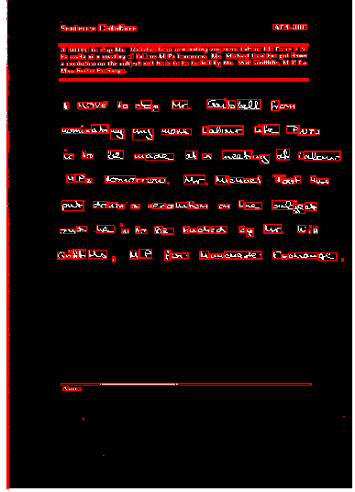
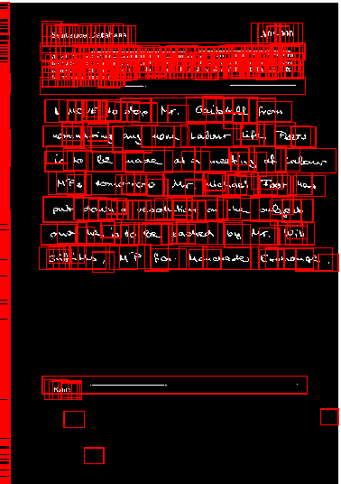
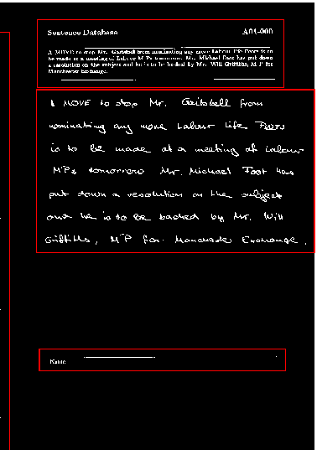
Bounding box expansion
In the last phase boxes that take only a small fraction of the total area are removed.
= Area of interest box

Slide 10
Layout Analysis 2
To find rows of text the run length smearing algorithm is used.
The RLSA finds rows of black pixels and changes them to white if they are under given threshold.
The bounding box is taken for each object generated by RLSA. These bounding boxes represent the rows.
The same method is used to find individual words within rows. For words the RLSA is executed also vertically. Smaller threshold values are used.

Slide 11
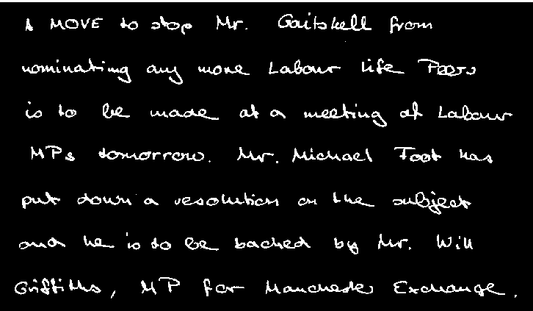
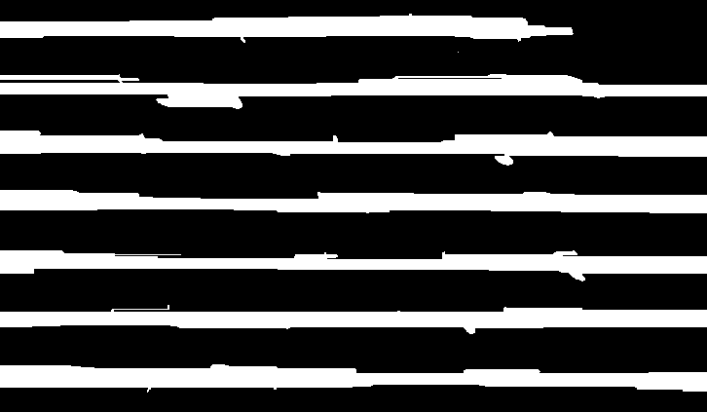

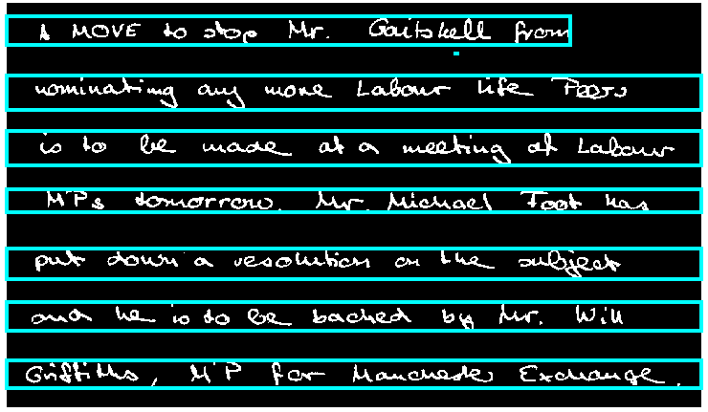
RLSA for rows
= Row box

Slide 12


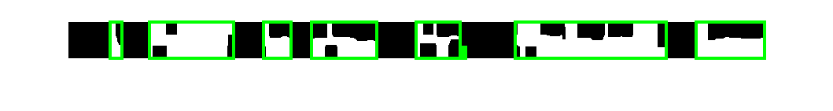
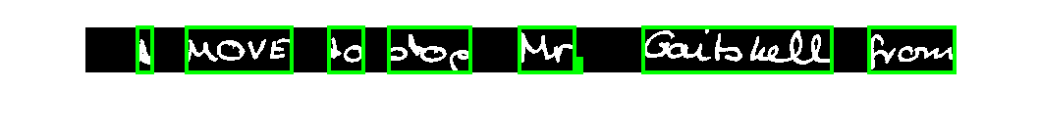
RLSA for words
= Word box
Same procedure but this time the algorithm is also run vertically to get dots or other broken characters into word.

Slide 13
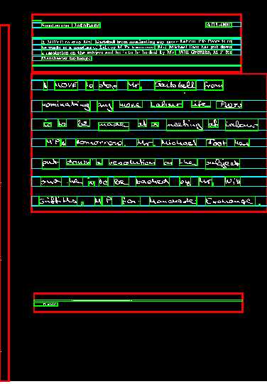
Full layout visualized
= Area of interest box
= Row box
= Word box

Slide 14
Tests
The system is still dependant on the threshold values.
The tests goal is to find these threshold values for IAM database.

Slide 15
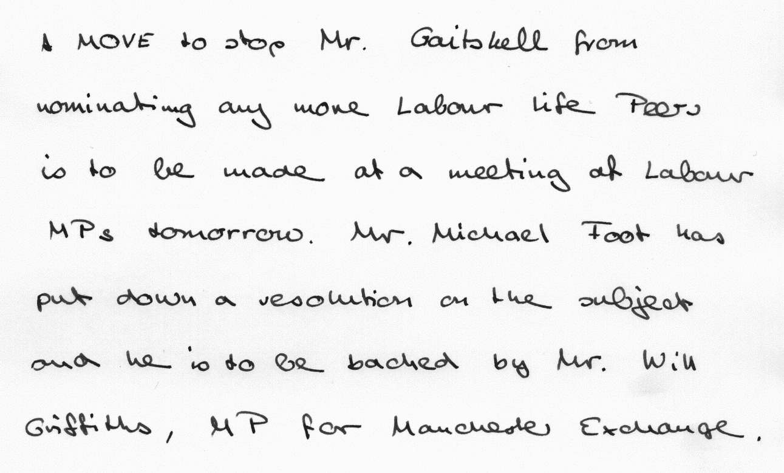
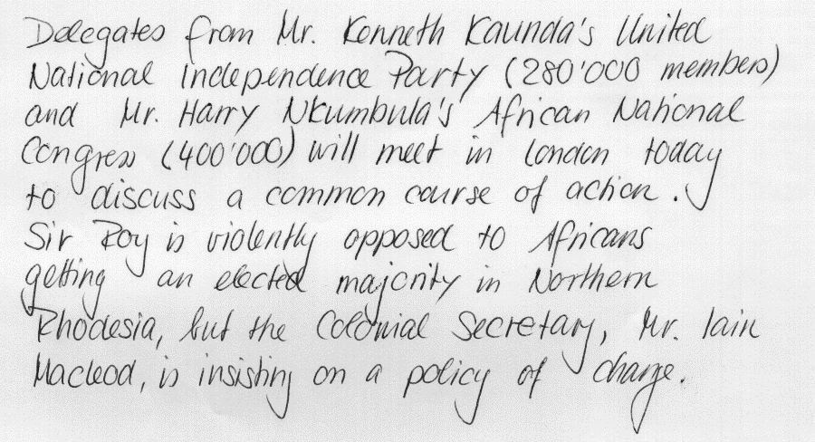
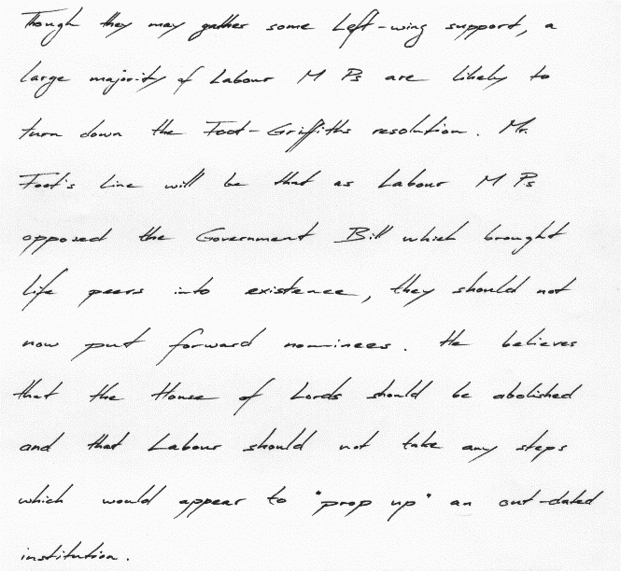
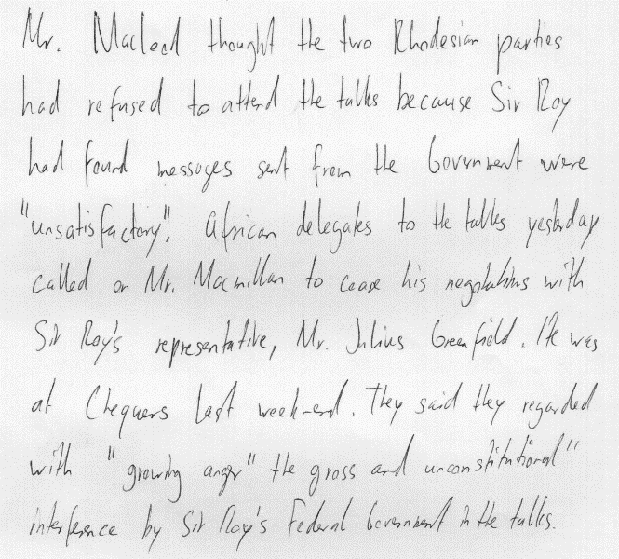
Example entries in IAM handwriting database.
The database contains also metadata from each picture such as number of rows and words

Slide 16
Test procedure
25 different handwriting samples and their metadata
Iterate through a list of tested values
With each iteration run the preprocessing and layout analysis for each image
Get the number of detected rows and words
Compare detected rows and words to the actual values
Visualize results

Slide 17
Test results
(aja testit yhdelle kuvalle kerrallaan katotaan sitte uudestaan)

Slide 18
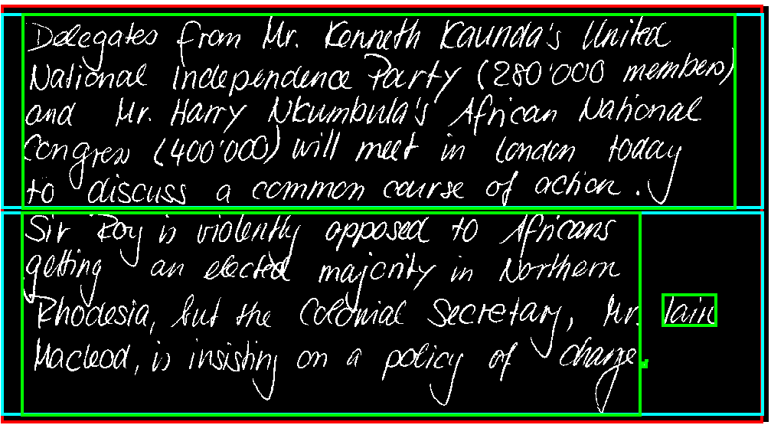
Remaining problems
The row and word detection isn’t perfect
If two rows contain overlapping characters those rows are combined as one.
Words can be broken or two or more words are combined as one.
= Area of interest box
= Row box
= Word box
Result: Two rows and five words!

Slide 19
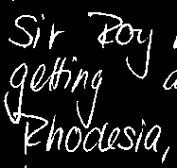
Remaining problems: Overlapping characters
= Real word box (unrealized)

